Slide 1
C++ Basics
Dr. Xiaolan Zhang
Fordham University

Slide 2
/* This is a program that simply prints out Hello world
to the terminal, and move cursor to next line
By X. Zhang,
*/
#include <iostream> //This is preprocessor directive
int main()
{
std::cout <<"Hello world\n"; //display to terminal window
// this is a blank line, added here for readability
return 0; //program exits, return 0 to indicate success
}
Curly braces enclose the body of function

Slide 3
/* This is a program that simply prints out Hello world
to the terminal, and move cursor to next line
By X. Zhang,
*/
#include <iostream> //This is preprocessor directive
using namespace std; // In order to use cin, cout etc declared in std
int main()
{
cout <<"Hello world\n"; //display to terminal window
// this is a blank line, added here for readability
return 0; //program exits, return 0 to indicate success
}
Curly braces enclose the body of function

Slide 4
Keyword
In previous example, the following words are keywords of C++
int, main, return, using …
Keywords (also called reserved words)
Are used by the C++ language
Must be used as they are defined in the programming language
Cannot be used for other purposes

Slide 5
Special characters in C++
# is used to start a directive
; is used to end an statement
// is used to start a single line of comments
/* and */ are used to enclose multi-line comments
Double quotation marks " used to enclose a string constant
Note that this is not the same as “”
Single quotation marks used to enclose a character constant
Important to use plain text editor to edit your program: not word, WordEdit, as they introduce other characters, and convert quotations marks…

Slide 6
cout statement
cout <<"Hello world\n";
cout: pronounced as see-out, stands for character output
Defined in iostream, a header file (a source code) that is part of C++ standard library
Represents the terminal window that the program is running from
<< insertion operator: to insert (display) something in terminal window
Can display multiple values in single statement, e.g.,
cout <<"Hello world, " << "this is my first program!\n";
cout <<"Hello world, "
<< “this is my first program!\n";
One statement can be split
into multiple lines.

Slide 7
Goals
Most programming tasks involve manipulating data. Today, we will:
describe how to input and output data
present the notion of a variable for holding data
To understand the properties and limitations of integer and floating-point numbers
To be able to define and initialize variables and constants
To use the standard C++ string type to define and manipulate character strings
introduce the central notions of “Type” and “Type Safety”

Slide 8
Computation
Code
(input) data
(output) data
data
Input: from keyboard, files, other input devices, other programs, other parts of a program
Computation – what our program will do with the input to produce the output.
Output: to screen, files, other output devices, other programs, other parts of a program

Slide 9
Program structure
Single batch of input
Multiple batch of input
1 Read inputs
2 Computation
3 Write output
1 Read inputs
2 Computation
3 Write output
4 Go back to 1

Slide 10
Input and oOytpt
Input and Output
// read first name:
#include <iostream>
#include <string>
using namespace std;
int main()
{
cout << "Please enter your first name (followed " << "by 'enter'):\n";
string first_name;
cin >> first_name;
cout << "Hello, " << first_name << '\n';
}
// note how several values can be output by a single statement
// a statement that introduces a variable is called a declaration
// a variable holds a value of a specified type
// the final return 0; is optional in main()
// but you may need to include it to pacify your compiler

Slide 11
Input and Type
We read data/or input into a variable
Here, first_name
A variable has a type
Here, string
The type of a variable determines what operations we can do on it
Here, cin>>first_name; reads characters until a whitespace character is seen
White space: space, tab, newline, …

Slide 12
Overview
Variables and Assignments
Data Types and Expressions
Input and Output
Program Style

Slide 13
C++ Variables
Variables are like small blackboards
We can write a number on them
We can change the number
We can erase the number
C++ variables are memory locations
We can write a value in them
We can change the value stored there
We cannot erase the memory location
Some value is always there

Slide 14
C++ Variables
A variable is some memory that can hold a value of a given type
A variable has a name
Each variable has name, type, value
A declaration names a variable
int a = 7;
char c = 'x';
string s = "qwerty";
a:
7
c:
'x'
s:
6
"qwerty"
Size of memory varies for objects
of different types !

Slide 15
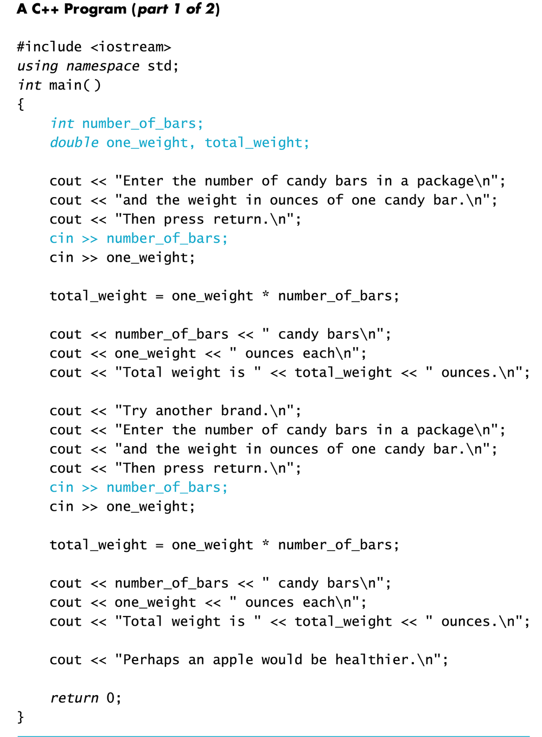
Display 2.1 (1/2)

Slide 16
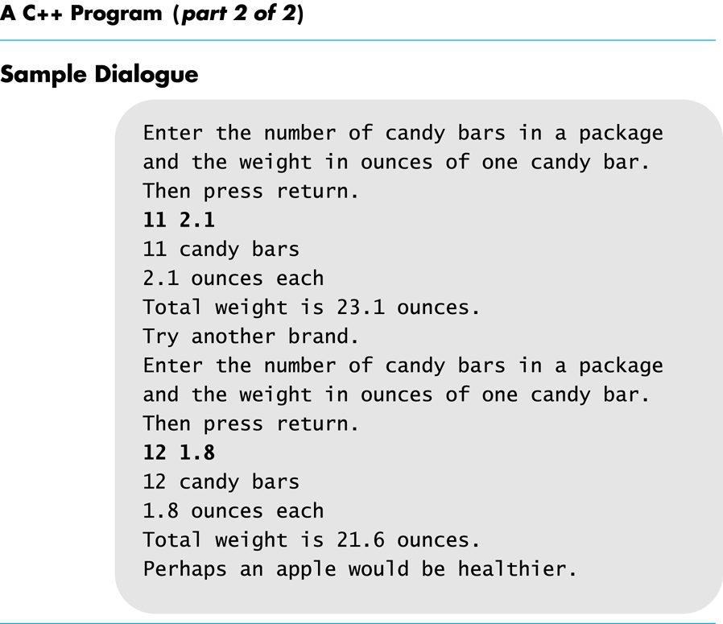
Display 2.1 (2 /2)

Slide 17
Identifiers
Variables names are called identifiers
Choosing variable names
Use meaningful names that represent data to be stored
First character must be
a letter or the underscore character, _
Remaining characters must be
Letters, numbers, underscore character
Keywords, such as return, main, if, … cannot be used as identifiers

Slide 18
Declaring Variables
Before use, variables must be declared
Declaration syntax:
type_name variable_1 , variable_2, . . . ;
Tells the compiler: I need variable(s) named … to store .. type of data
int number_of_bars; double one_weight, total_weight;
Try this: what does the above three declarations say?
How about this? char response, option;

Slide 19
Two locations for variable declarations
Immediately prior to use
int main() { … int sum; sum = score1 + score 2; … return 0;
}
At the beginning int main() { int sum; … sum = score1 + score2;
… return 0; }

Slide 20
Assignment Statements
An assignment statement changes the value of a variable
total_weight = one_weight + number_of_bars;
total_weight is set to the sum one_weight + number_of_bars
Assignment statements end with a semi-colon
Left hand side (LHS): variable whose value is to be changed
Right hand side (RHS): new value for the LHS variable:
Constants -- age = 21;
Variables -- my_cost = your_cost;
Expressions -- circumference = diameter * 3.14159;

Slide 21
Assignment Statements
The ‘=‘ operator in C++ is not an equal sign
The following statement cannot be true in algebra
number_of_bars = number_of_bars + 3;
In C++ it means the new value of number_of_bars is the previous value of number_of_bars plus 3

Slide 22
Initializing Variables
Declaring a variable does not give it a value
Giving a variable its first value is initializing the variable
Variables are initialized in assignment statements double mpg; // declare the variable mpg = 26.3; // initialize the variable
Declaration and initialization can be combined
Method 1 double mpg = 26.3, area = 0.0 , volume;
Method 2 double mpg(26.3), area(0.0), volume;

Slide 23
Exercises
Can you
Declare and initialize two integers variables to zero? The variables are named feet and inches.
Declare and initialize two variables, one int and one double? Both should be initialized to the appropriate form of 5.
Give good variable names for identifiers to store
the speed of an automobile?
an hourly pay rate?
the highest score on an exam?

Slide 24
Overview
Variables and Assignments
Data Types and Expressions
Input and Output
Program Style

Slide 25
Types
C++ provides a set of types
E.g. bool, char, int, double
Called “built-in types”
C++ programmers can define new types
Called “user-defined types”
We'll get to that eventually
C++ standard library provides a set of types
E.g. string, vector, complex
Technically, these are user-defined types
they are built using only facilities available to every user
Notes:
Built-in or Primitive datatypes—Holding single value. Non-Primitive or User-define datatypes—build on the top primitive datatypes, holding multiple values. E.g. Array, class, string

Slide 26
Builtin Types (1)
Boolean type represents value of true or false
bool
ex: bool invalidInput; // used to mark invalid input
Character type represents a single character, such as q, a, B, \n, (, …
char
Ex: char choice = ‘q’;

Slide 27
Builtin Types (2):Integer Number types
Integer numbers (int, short,long) are whole numbers without a fractional part
Includes zero and negative numbers
Used for storing values that are conceptually whole numbers (e.g. pennies)
Process faster and require less storage space (compared to floating-point numbers)

Slide 28
Types and literals
int pennies = 8;
cout << " Hello world\n ";
Literal constants: values that occurs in the program
Literal, as we can only speak of it in terms of its value
Constant: its value cannot be changed
How to write literals?
Depending on the type of the literal
8 is of type int, “Hello world\n” is of type string
More examples:
bool validInput = true;
bool continue = false; // reserved words
Character literals: 'a', 'x', '4', '\n', '$'.
Integer literals: 0, 1, 123, -6, 0x34, 0xa3, 024
Floating point literals: 1.2, 13.345, .3, -0.54, 1.2e3, . 3F, .3F
String literals: "asdf", "Howdy, all y'all!“

Slide 29
Builtin Types(3): Floating point types
Floating-point types represents number with decimal points, such as 3.14
double, and float
Process slower and require more storage space

Slide 30
Type char
char: can be any single character from the keyboard
To declare a variable of type char:
char letter;
Character constants are enclosed in single quotes char letter = 'a';
Strings constant, even if contain only one character, is enclosed in double quotes
cout << "Hello world ";
"a" is a string of characters containing one character
'a' is a value of type character

Slide 31
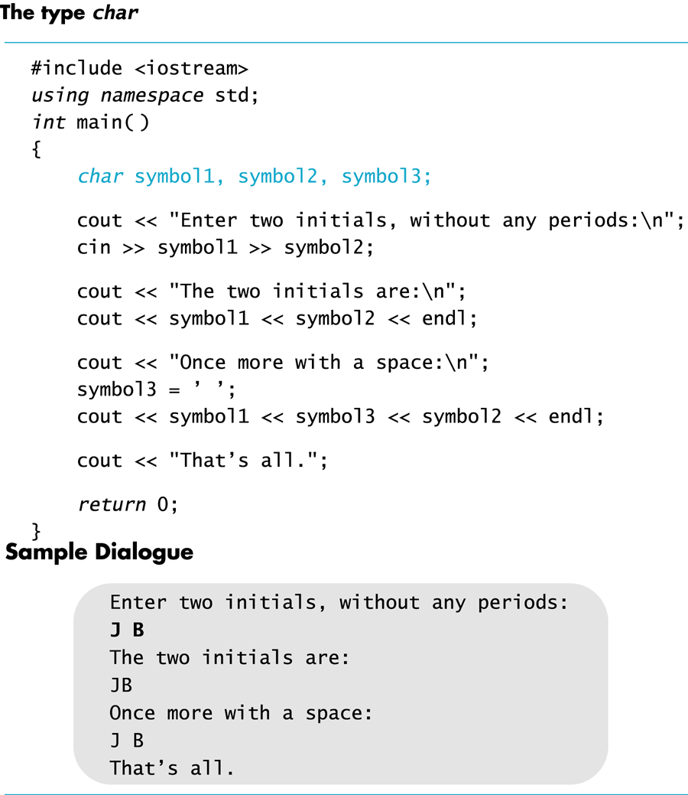

Slide 32
More on floating point constants
Simple form must include a decimal point
e.g., 34.1 23.0034 1.0 89.9
Scientific Notation form
e.g. 3.41e1 means 34.1 3.67e17 means 367000000000000000.0 5.89e-6 means 0.00000589
Number left of e does not require a decimal point
Exponent cannot contain a decimal point

Slide 33
C++ Standard Library Type: string
string is a class, different from primitive data types discussed so far
Requires the following be added to the top of your program:
#include <string>
Use double quotes around the text to store into the string variable
To declare a variable of type string: string name = "Apu Nahasapeemapetilon";

Slide 34
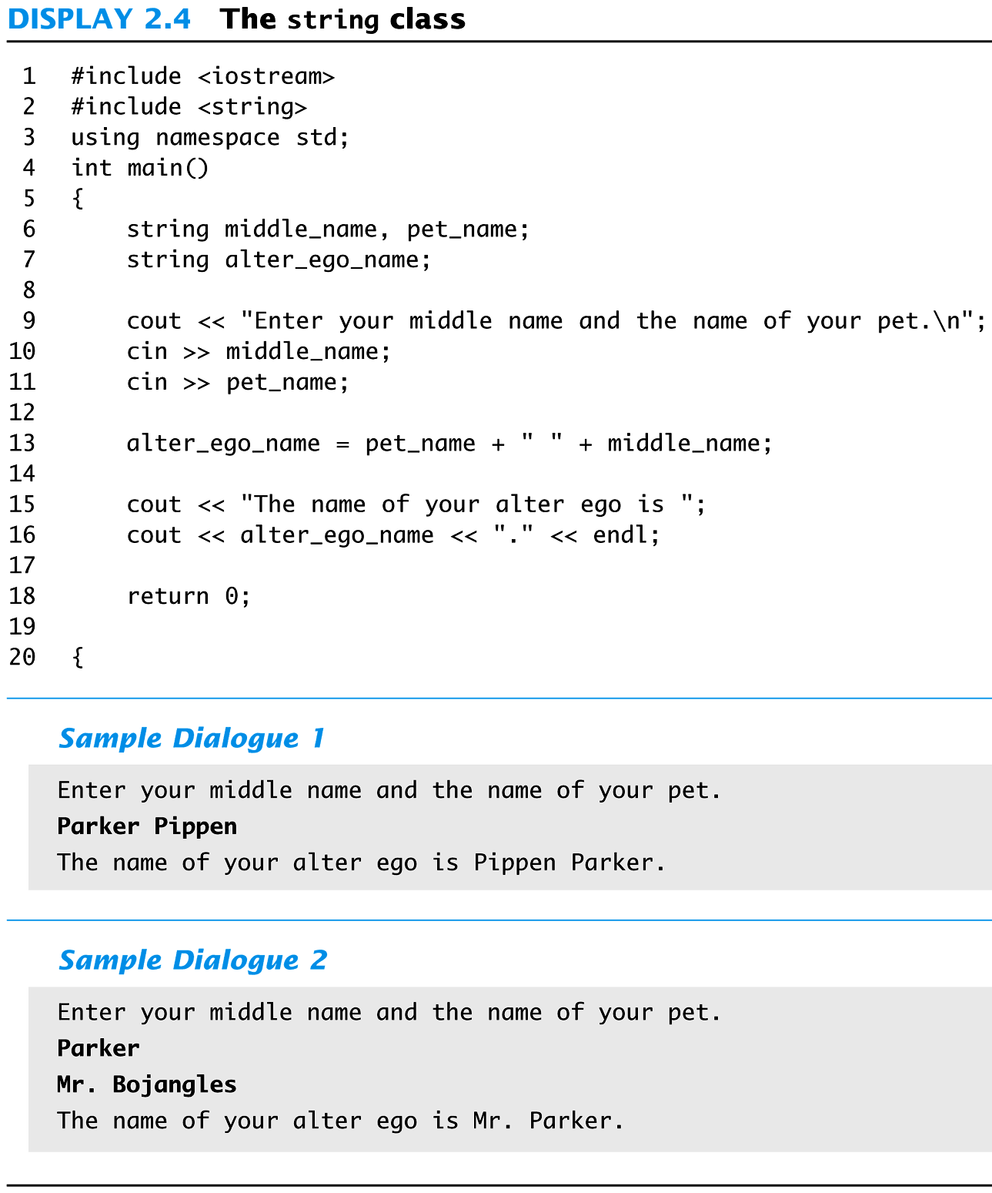

Slide 35
Overview
Variables and Assignments
Data Types
Expressions
Input and Output
Program Style

Slide 36
Operation on data
Once we have variables and constants, we can begin to operate with them.
C++ defines operators.
Operators in C++ are mostly made of signs that are not part of alphabet but are available in all keyboards.
Shorter C++ code and more international

Slide 37
Operators
Assignment (=)
The assignment operator assigns a value to a variable.
Arithmetic operators ( +, -, *, /, % )
five arithmetical operations supported by the C++ language are
Addition: +
subtraction: -
Multiplication: *
Division: /
Modulo: %, gives remainder of a division of two values. a = 11 % 3; // a will contain the value of 2

Slide 38
Assignment and increment
a:
// changing the value of a variable
int a = 7; // a variable of type int called a
// initialized to the integer value 7
a = 9; // assignment: now change a's value to 9
a = a+a; // assignment: now double a's value
a += 2; // increment a's value by 2
// a shorthand notation for a = a+2;
++a; // increment a's value (by 1)
//shorthand notation for a = a+1;
7
9
18
20
21

Slide 39
Simple arithmetic
// do a bit of very simple arithmetic:
#include <math.h>
int main()
{
cout << "please enter a floating-point number: "; // prompt for a number
double n; // floating-point variable
cin >> n;
cout << "n == " << n
<< "\nn+1 == " << n+1 // '\n' means “a newline”
<< "\nthree times n == " << 3*n
<< "\ntwice n == " << n+n
<< "\nn squared == " << n*n
<< "\nhalf of n == " << n/2
<< "\nsquare root of n == " << sqrt(n) // library function
<< endl; // another name for newline
}
If the user enters 25 upon the prompt, what’s the output?

Slide 40
Arithmetic Expressions
Arithmetic operators can be used with any numeric type, i.e., operand can be any numeric type
Result of an operator depends on types of operands
If both operands are int, result is int
If one or both operands are double, result is double

Slide 41
Division of Doubles
Division with at least one double operand produces expected results double divisor, dividend, quotient; divisor = 3.0; dividend = 5.0; quotient = dividend / divisor; result: quotient = 1.6666…
Result is same if either dividend or divisor is of type int

Slide 42
Division of Integers
int / int produces an integer result int dividend, divisor, quotient; dividend = 5; divisor = 3; quotient = dividend / divisor;
The value of quotient is 1, not 1.666…
Integer division does not round result, fractional part is discarded!

Slide 43
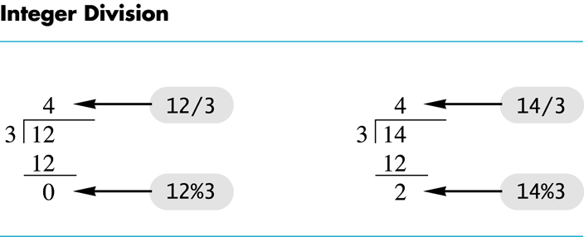
Integer Remainders
% operator gives remainder from integer division
int dividend, divisor, remainder; dividend = 5; divisor = 3; remainder = dividend % divisor; The value of remainder is 2

Slide 44
Discussion
“Giving changes” for Cashier program
Instruct the cashier to give changes, e.g., a change of $12.34 should be given in
One 10 dollar bill
two 1 dollar bills
One quarter
One nickel
Four pennies

Slide 45
Arithmetic Expressions
Use spacing to make expressions readable
Which is easier to read? x+y*z or x + y * z
Precedence rules for operators are the same as used in your algebra classes
Use parentheses to alter the order of operations x + y * z ( y is multiplied by z first) (x + y) * z ( x and y are added first)

Slide 46
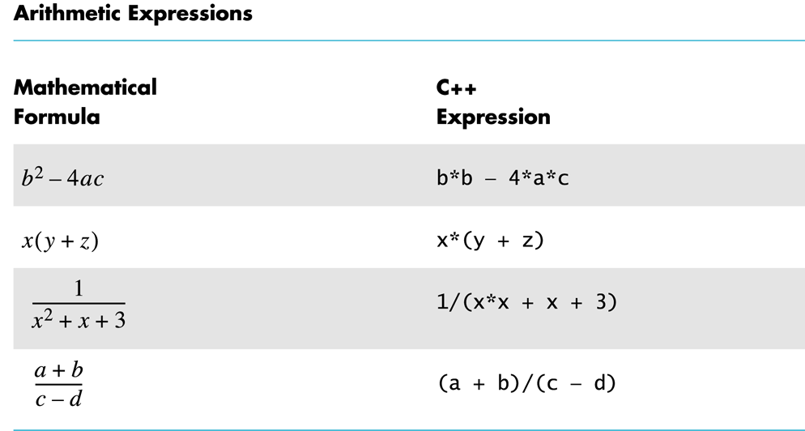

Slide 47
Operator Shorthand
Operator shorthand: can be used when applying an arithmetic operation on a variable and saving result back to the varilable,
+=
e.g., count = count + 2; becomes count += 2;
*=
e.g., bonus = bonus * 2; becomes bonus *= 2;
/=
e.g., time = time/rush_factor; becomes time /= rush_factor;
%=
e.g., remainder = remainder % (cnt1+ cnt2); becomes remainder %= (cnt1 + cnt2);

Slide 48
Increment/Decrement
Unary operators require only one operand
+ in front of a number such as +5
- in front of a number such as -5
++ increment operator
Adds 1 to value of a variable x ++; is equivalent to x = x + 1;
-- decrement operator
Subtracts 1 from value of a variable x --; is equivalent to x = x – 1;

Slide 49
Overview
Variables and Assignments
Data Types
Expressions
Input and Output
Program Style

Slide 50
Input and Output
A data stream is a sequence of data: in the form of characters or numbers
An input stream is data for the program to use, originating from keyboard, a file …
An output stream is the program’s output, destining to monitor, or a file , ..
Include directives: add library files to our programs
To make definitions of the cin and cout available : #include <iostream>
Using directives: include a collection of defined names
To make names cin and cout available to our program: using namespace std;

Slide 51
Output using cout
cout is an output stream for program to send data to monitor
insertion operator "<<" inserts data into cout
cout << number_of_bars << " candy bars\n";
sends two items to monitor: value of number_of_bars, and quoted string constant
No space added between items, therefore space before the ‘c’ in candy,
A blank space can also be inserted with cout << name << " " <<age <<endl ;
A new insertion operator is used for each item of output
same as
cout << number_of_bars ; cout << " candy bars\n";
cout an expression directly
cout << "Total cost is $" << (price + tax);

Slide 52
Formatting Output
Escape sequences: tell the compiler to treat characters in a special way, allow one to specify special characters
'\' is escape character
To create a newline in output use \n, or endl; cout << "Hello\n"; cout << "Hello"<<endl;
Other escape sequences: \t -- a tab \\ -- a backslash character \" -- a quote character
When printing receipt, use \t to line up different columns
Other ways possible …

Slide 53
Formatting Real Numbers
Real numbers (type double) produce a variety of outputs double price = 78.5; cout << "The price is $" << price << endl;
output could be any of these: The price is $78.5 The price is $78.500000 The price is $7.850000e01
unlikely to get: The price is $78.50

Slide 54
Showing Decimal Places
cout includes tools to specify the output of type double
To specify fixed point notation
setf(ios::fixed)
To specify that decimal point will always be shown
setf(ios::showpoint)
To specify that two decimal places will always be shown
precision(2)
e.g.: cout.setf(ios::fixed); cout.setf(ios::showpoint); cout.precision(2); cout << "The price is $" << price << endl;

Slide 55
Input Using cin
cin is an input stream bringing data from the keyboard
extraction operator (>>) removes data to be used
e.g., cout << "Enter the number of bars in a package\n"; cout << " and the weight in ounces of one bar.\n"; cin >> number_of_bars; // program will wait for input cin >> one_weight;
code prompts user to enter data then reads two data items from cin
first value read is stored in number_of_bars
second value read is stored in one_weight
Data is separated by spaces when entered

Slide 56
Reading Data From cin
Multiple data items are separated by spaces (space, tab, newline)
cin skips blanks and line breaks looking for data
Data is not read until enter key is pressed
Allows user to make corrections
cin >> v1 >> v2 >> v3;
Requires three space separated values
User might type 34 45 12 <enter key>
Or
34 <enter key>
45 <enter key>
12 <enter key>

Slide 57
Reading Character Data
following reads two characters but skips any space that might be between char symbol1, symbol2; cin >> symbol1 >> symbol2;
User normally separate data items by spaces J D
Results are same if data is not separated by spaces JD

Slide 58
Designing Input and Output
Prompt the user for input that is desired
cout statements provide instructions cout << "Enter your age: "; cin >> age;
Notice the absence of a new line before using cin
Echo the input by displaying what was read
Gives the user a chance to verify data cout << age << " was entered." << endl;

Slide 59
Exercise
Can you
write an input statement to place a value in the variable the_number?
Write the output statement to prompt for the value to store in the_number?
Write an output statement that produces a newline?
Format output of rational numbers to show 4 decimal places?

Slide 60
Overview
Variables and Assignments
Data Types
Expressions
Input and Output
Constants

Slide 61
Program Style - Constants
Literal constants: have no mnemonic value, i.e., no name
total_price = large*14.82+small*12.34;
cout << ″Hello world″;
Cons: difficult to find and change when needed, harder to understand
Named constants: give a name to a constant
Allow us to change all occurrences simply by changing value of constant
e.g.: const int WINDOW_COUNT = 10; declares a constant named WINDOW_COUNT
const is keyword to declare a constant
Its value cannot be changed by the program (unlike a variable)
Common practice: name constants with all capitals

Slide 62
Summary
New concepts:
Variable, identifier, data type
Expressions
Statements: declaration statements, assignment statements
Constant: literal constant and named constant
We learnt how to
Declare a variable
Assign value to a variable
Input/output: how to read a value from keyboard, how to write to terminal (or, monitor)
Write arithmetic expressions

